Slide 1
Smart Electronic Voting Machine Using Fingerprint Sensor
Name of Group members: Ujwal Kumar S(R22EM085)
Sharanya C S(R22EM077)
Keerthan K(R22EM105)
Venkatesh Warlu K(R22EM090)
School: EEE
REVA UNIVERSITY
Guide: Dr.Sudharani Potturi
Designation

Slide 2
Smart Electronic Voting Machine Using Fingerprint Sensor
School of Electrical and Electronics Engineering

Slide 3
Content
Abstract
Acknowledgment
Introduction
Objectives
Literature
Methodology
Milestones
Results and discussion
Contribution
Conclusion
Future Scope

Slide 4
Abstract
The Smart Electronic Voting Machine is a secure and efficient system that leverages modern technology to address challenges in traditional voting systems. It uses biometric authentication to ensure that only registered voters can participate. The Arduino Uno acts as the central processing unit, while the LCD display, push buttons, and buzzer facilitate user interaction and feedback. This project aims to enhance transparency, reliability, and security in the voting process.

Slide 5
Acknowledgement
We are deeply grateful to Dr. Sudharanai Potturi, our project guide, for her constant support, expert guidance, and invaluable encouragement throughout the journey of developing our project, Smart Electronic Voting Machine. Her vast knowledge, patience, and dedication have inspired us to tackle challenges with confidence and a problem-solving mindset. She has been instrumental in helping us understand the intricacies of the project, ensuring that we approach every aspect with precision and clarity.
We would also like to express our sincere gratitude to our institution and the faculty members for providing us with the resources, facilities, and learning environment required for the successful completion of this project. Their unwavering support has been a pillar of strength in our academic and project endeavors. Finally, we extend our heartfelt thanks to our peers and team members for their collaborative spirit and commitment, which made this project a truly enriching experience.

Slide 6
Introduction
Background: Voting is the cornerstone of democracy, but traditional systems face issues like impersonation, manual errors, and inefficiency. The integration of biometric technology and electronics can modernize and secure the voting process.
Importance of Investigation
Prevent unauthorized voting with biometric authentication.
Enhances the transparency and confidence of Voter.
One can expect accurate and precise results.
Provides scalable solutions for elections of different parties.

Slide 7
What others have done in this area?
Biometric-Based Voting Systems: Previous studies have explored biometric systems, such as fingerprint and facial recognition, to improve voter authentication.
Smart Systems Integration: Research has been conducted on integrating IoT and wireless communication for remote monitoring of voting systems, aiming to enhance accessibility and result aggregation.
Prototype Models: Academic projects have developed small-scale systems using Arduino or similar microcontrollers, focusing on ease of implementation and cost-effectiveness. These efforts have demonstrated the feasibility of combining biometric sensors with microcontrollers for secure voting.

Slide 8
Literature review
The concept of electronic voting systems has been extensively studied and implemented worldwide, with the aim of ensuring secure, efficient, and transparent electoral processes.
1. Traditional Voting Systems and Challenges: Studies highlighted the limitations of paper-based voting systems, including risks of voter fraud, ballot tampering, and logistical inefficiencies. EV systems aims to address these challenges by automating the process and enhancing the security through technology.
2. Arduino-Based Voting Systems: Studies like those by Kumar and Rao (2019) explored the use of Arduino microcontrollers in developing cost-effective and scalable electronic voting machines. Arduino’s versatility and compatibility making use of various sensors could make it a popular choice for prototyping and small-scale implementations.

Slide 9
3. Security Concerns and Solutions: Literature by Chen et al. (2021) discusses potential vulnerabilities in electronic voting systems, including hacking and tampering. Modern systems are addressing these concerns by integrating encryption, tamper-detection mechanisms, and secure data storage solutions.
4. Global Implementation Trends: Countries like Estonia have implemented electronic and online voting systems successfully, showcasing the potential of such technology to revolutionize elections. However, challenges such as public trust, cybersecurity, and scalability remain areas of ongoing research.
5. Relevance to Developing Nations: Research emphasizes that electronic voting systems, especially those based on affordable platforms like Arduino, can significantly improve election management in developing nations. These systems are adaptable to diverse infrastructural and socio-political contexts.

Slide 10
objectives
Enhance Security: By using fingerprint recognition, the system ensures that only authorized individuals can cast their votes, reducing the risk of voter impersonation or fraudulent activities.
Streamline Voting Process: Voting Process can be Fast enough
Ensure Transparency: each vote is uniquely associated with the voter's identity, preventing duplication or manipulation of votes.
Promote Trust in the Electoral System: By adopting modern biometric technology, the system aims to enhance public trust in the electoral process, ensuring the integrity of elections.

Slide 11
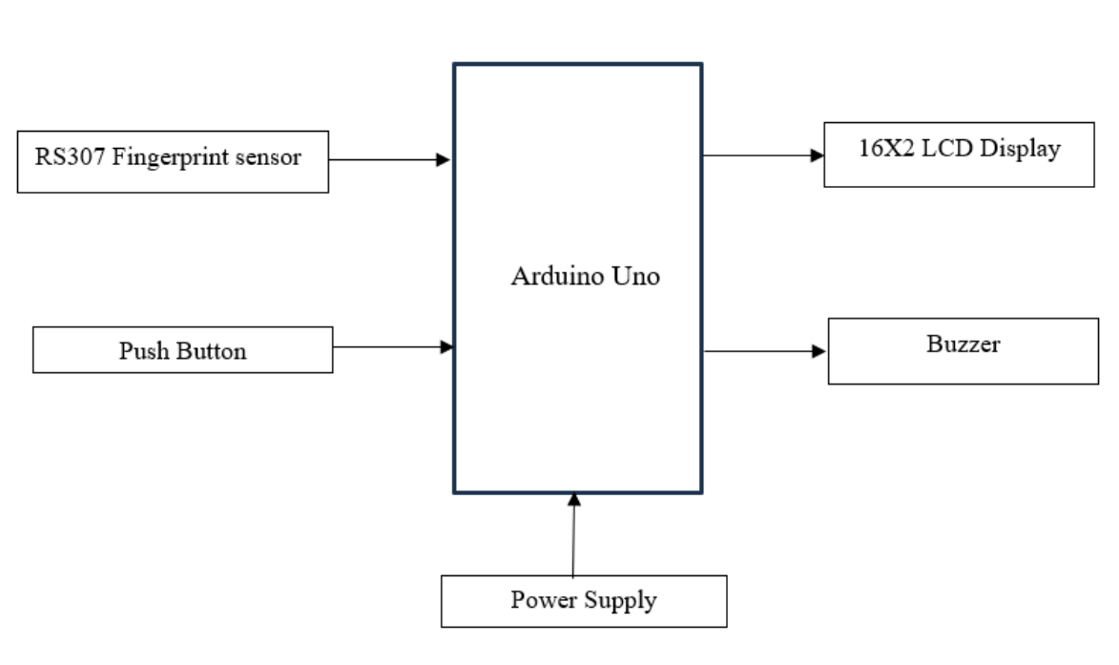
Block diagram

Slide 12
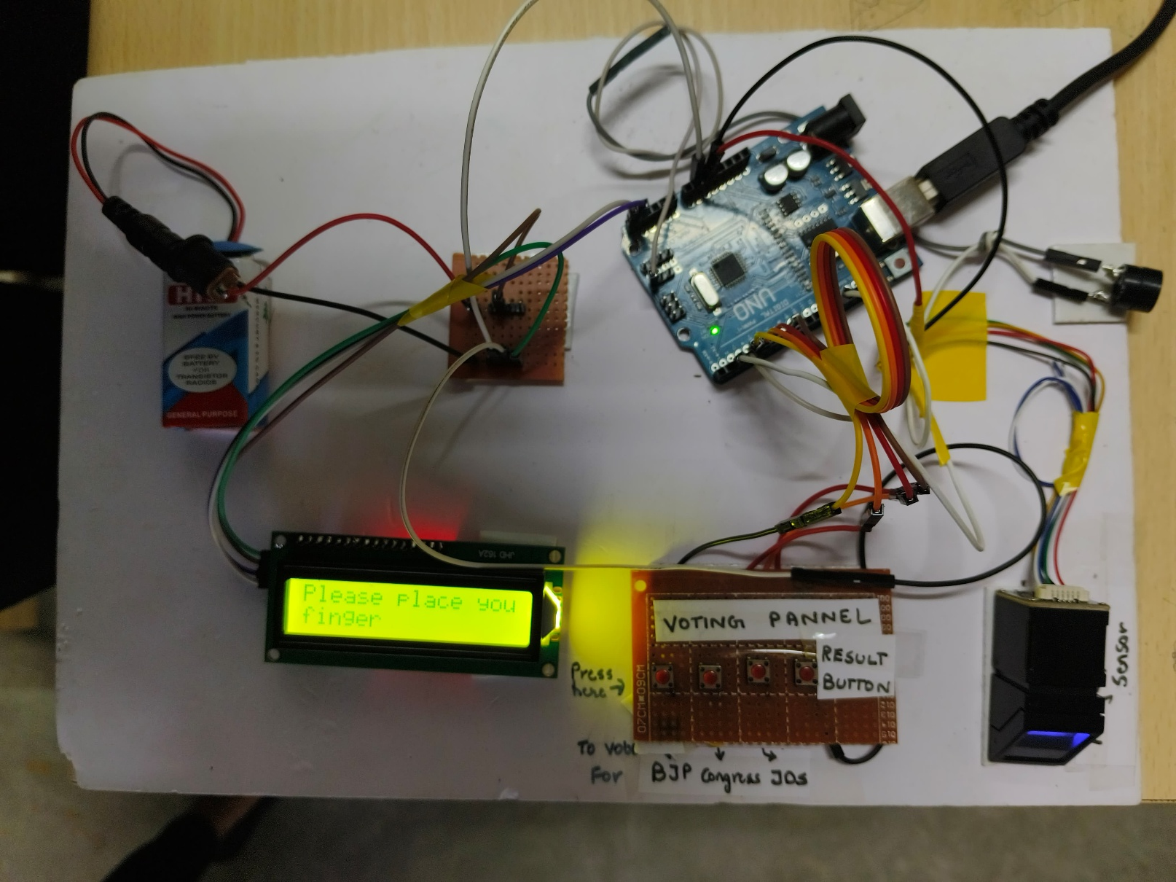
Hardware

Slide 13
Methodology
1.System Design: The System of Our project Includes components such as Arduino Uno,R307S Fingerprint Sensor , Buzzers and Pushbuttons.
After Listing out the Components we designed the block diagram which give us the detail of how our project is going to be worked
2. Hardware Integration:
Usage Of Fingerprint sensor to record the fingerprint data and to match the enrollment process.
Next, it is Connected to the Arduino UNO for Data Processing.
Used 16*2 LCD display for displaying the instructions , candidate options and results.
Push buttons are connected to select and confirm the vote.
At last, the usage of Buzzers are added to provide auditory feedback for system responses such as successful vote authentication or vote confirmation.

Slide 14
3. Fingerprint Enrollment: Collecting and stored voter fingerprints using the R307S sensor.Stored the fingerprints in the sensor's internal memory for comparison during the voting process.
4. Voting Process Implementation: Voter places their finger on the R307S sensor and the system verifies the fingerprint against the stored database and If the fingerprint matches, access is granted, and the voting process begins.
5. Vote Casting: Candidate names are displayed on the LCD display where Voter can select a candidate using push buttons and the system records the vote, and the buzzer confirms the selection.
6. Result Compilation: Once the voting period ends, the system displays the total votes for each candidate on the LCD display and Ensured results are stored securely and can be accessed for verification.
7. Testing and Troubleshooting:Conducted unit testing for each component to ensure functionality.
Also, Performed integration testing to verify seamless communication between components.
Debugged and optimized the Arduino code for efficient performance.

Slide 15
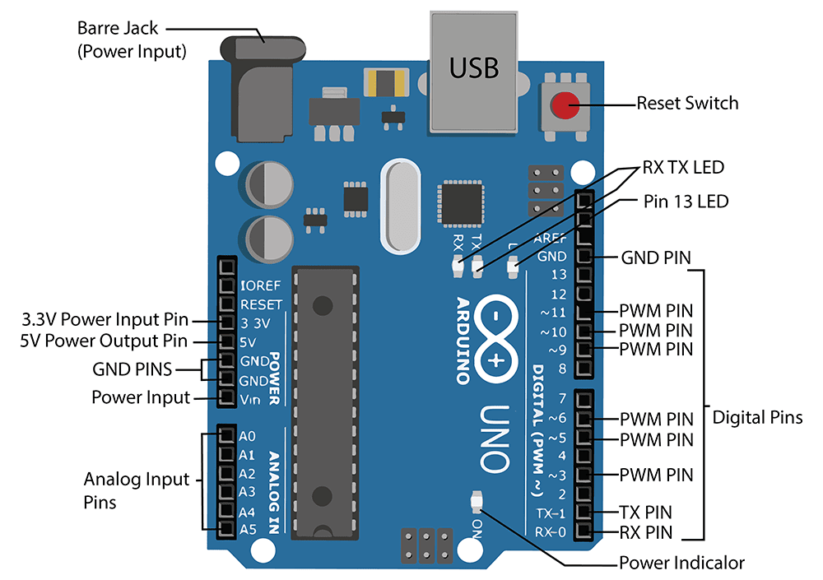
DESIGN DETAILS (SPECIFICATION)
1. Arduino Uno R3
Microcontroller: ATmega328P
Operating Voltage: 5V
Input Voltage (recommended): 7-12V
Digital I/O Pins: 14 (6 PWM outputs)
Analog Input Pins: 6
Flash Memory: 32 KB (0.5 KB used by bootloader)
SRAM: 2 KB
Clock Speed: 16 MHz

Slide 16
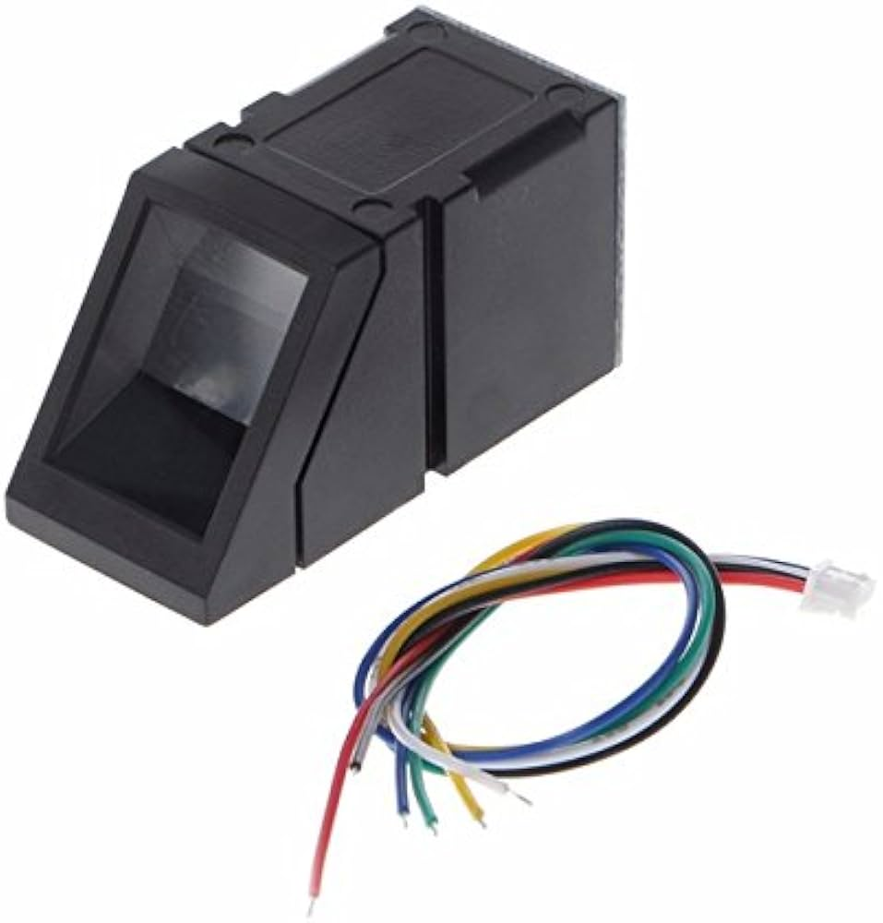
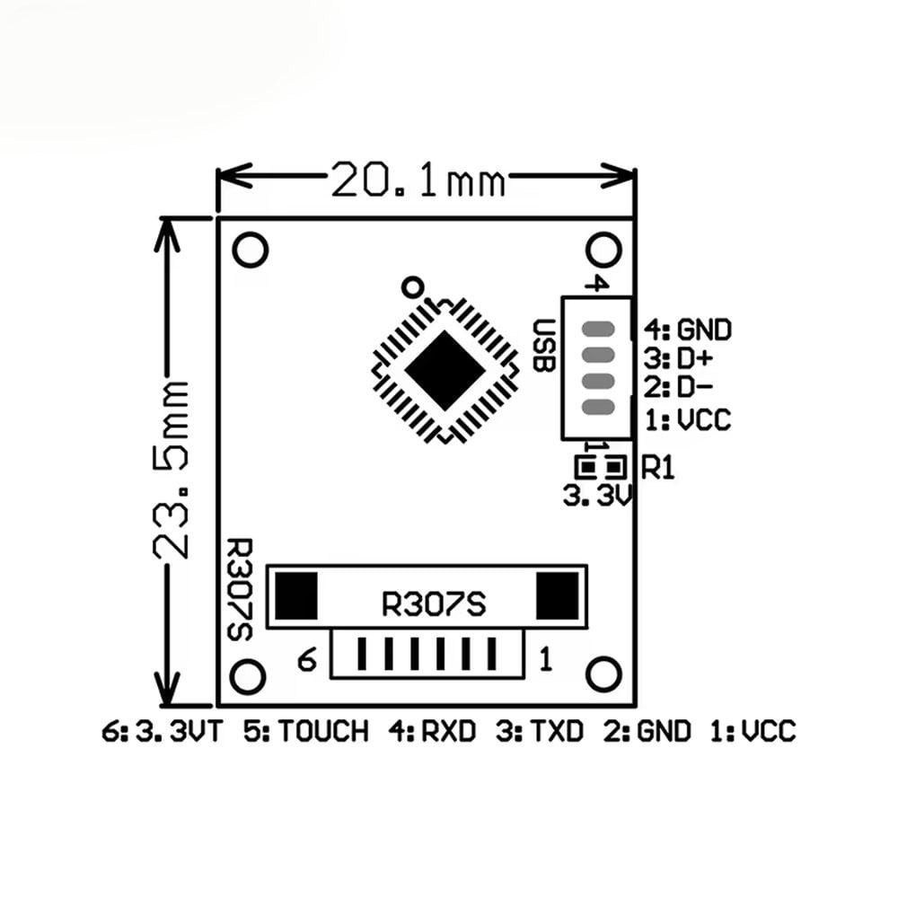
2. Fingerprint Sensor (R307S)
Fingerprint Capture Resolution: 508 DPI
Matching Speed: < 1 second
Fingerprint Capacity: Up to 1,000 fingerprints
Communication Interface: UART (TTL Logic)
Operating Voltage: 3.6V - 6V DC
Dimensions: 55 x 20 x 21.5 mm
R307S Fingerprint Sensor

Slide 17
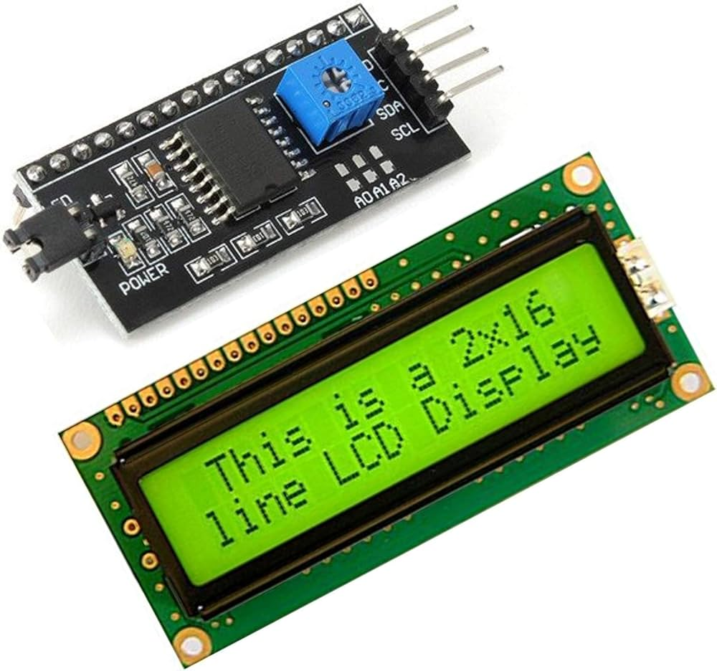
3. LCD Display with I2C Interface
Display Type: Alphanumeric LCD (16x2 characters)
Communication Interface: I2C (Integrated Circuit Interconnect)
I2C Address: Default 0x27 (adjustable onboard potentiometer )
Backlight: LED backlight (white or blue) with adjustable contrast
Power Supply Voltage: 5V DC
Operating Current: ~25 mA (with backlight on)
LCD Display(with I2c Interface)

Slide 18
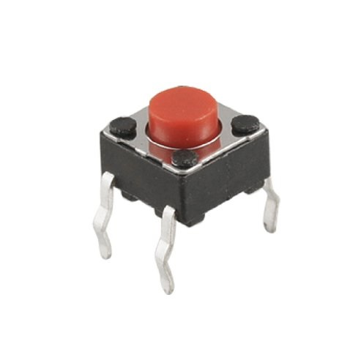
4. Push Buttons :
Type: Momentary (Normally Open)
Rated Voltage: 12V DC
Operating Current: < 50 mA
Contact Resistance: ≤ 50 mΩ
Size: ~6 x 6 mm (standard)
Debouncing Circuit: Required in software or hardware
Push Button

Slide 19
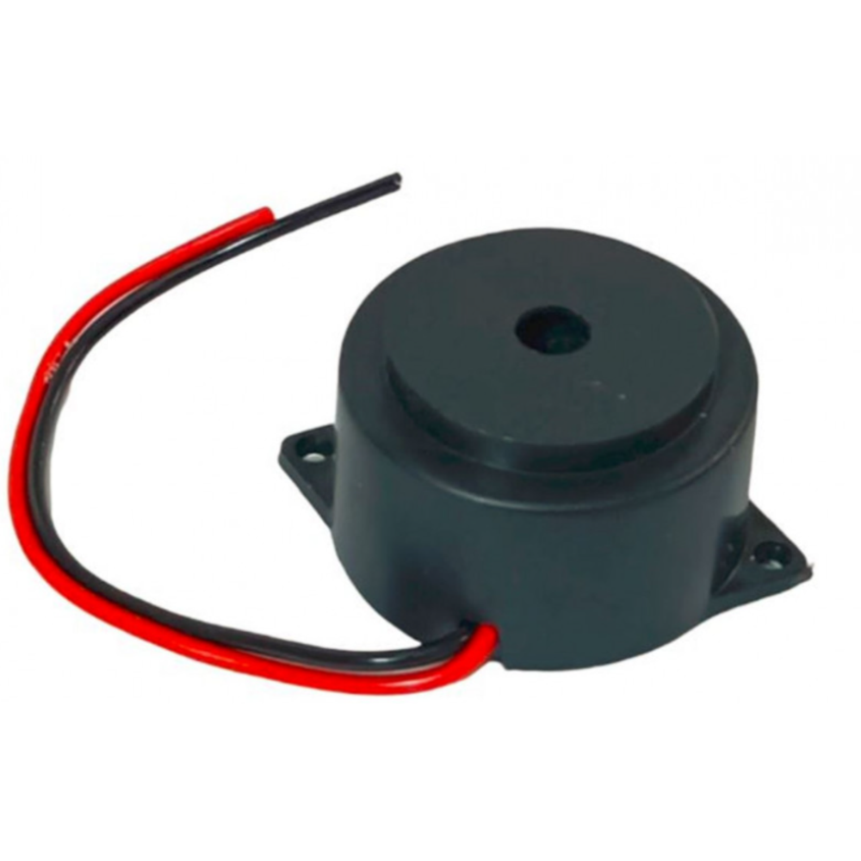
5. Active Buzzer
Operating Voltage: 3-5V DC
Rated Current: ~10 mA
Sound Frequency: ~2,300 Hz
Dimensions: ~12 x 9 mm
Connection: Two pins (positive and negative)
Trigger Method: Direct pin control from the microcontroller
Buzzer

Slide 20
Milestone | Activities | Time Period | Duration
Project Planning and Research | Identified Project idea Conducted Background research | Sep 16 2024 to Oct 5 2024 | 3 Weeks
Component Selection and procurement | Selected Required components | Oct 6 2024 to Oct 15 2024 | 10 days
Circuit Design and Assembly | Designed the layout of circuit | Oct 16 2024 to Nov 5 2024 | 3 Weeks
Software Development and Integration | Usage of Arduino IDE for Debugging | Nov 6 2024 to Dec 10 2024 | 5 Weeks
Testing | Tested System Functionality and Resolve errors | Dec 11 2024 to Dec 2025 | 2 Weeks
Documentation | Prepared Report and Powerpoint Slides | Dec 26 2024 to jan 2025 | 10 days

Slide 21
CONTRIBUTION DETAILS
Principle and Operation of the Circuit
Principle: The Smart Electronic Voting Machine operates on the principle of biometric authentication and digital data processing. The fingerprint sensor identifies and verifies unique voters, the Arduino Uno processes the data, and the LCD display shows the voting options and results.
Operation:
The voter places their finger on the fingerprint sensor (R307S).
The sensor captures the fingerprint and compares it to the pre-stored database.
If the fingerprint matches, the voting system is activated.
The voter uses push buttons to cast their vote, and the buzzer confirms a successful vote.
The vote is recorded, and the LCD display shows a success message.

Slide 22
2. Specifications of Circuit
Arduino Uno: 16 MHz clock speed, 32 KB flash memory.
Fingerprint Sensor (R307S): 9600 baud rate, 300 ms recognition time.
LCD Display: 128x64 resolution, I2C interface.
Push Buttons: Debounced digital inputs.
Buzzer: Operates at 5V with ~2 kHz frequency.

Slide 23
3. Contributions of Each Team Member
Team Member 1(Ujwal Kumar S): Project Planning and Selection of the Components
Team Member 2(Venkatesh Warlu K): Circuit Design and Assembly
Team Member 3(Keerthan K): Arduino Coding and Testing
Team Member 4(Sharanya C S): Documentation and presentation preparation.

Slide 24
4. Explanation and Interpretation of Results
Explanation: Each component worked as expected. The fingerprint sensor accurately verified identities, and the LCD displayed results promptly.
Interpretation: The system successfully ensures secure, error-free voting with real-time feedback.
5. Experimental Results and Discussion
Results:
The system achieved 100% accuracy in fingerprint verification during testing.
The voting process was seamless, and the display provided clear information.
Discussion: The Smart Electronic Voting Machine demonstrates how technology can make voting more secure and efficient. However, future improvements can include cloud data storage for results and real-time monitoring.

Slide 25
Future SCOPE
1.Integration with Cloud-Based Systems: cloud technology to store and manage voting data securely. This will enable real-time monitoring and centralized result aggregation, making the system more scalable and efficient for large-scale elections.
2.Remote Voting Capability : the system can allow voters to cast their votes remotely, ensuring accessibility for individuals with mobility challenges or those living in remote areas.
3.Multi-Modal Biometric Authentication: the system can be upgraded to include multi-modal biometrics, such as facial recognition or iris scanning, to improve security and cater to users with fingerprint-related issues
4.Green Technology Initiatives : Future versions can be designed to be environmentally friendly by using sustainable materials for hardware and energy-efficient electronics to reduce carbon footprints during manufacturing and operation.

Slide 26
CONCLUSION
The Smart Electronic Voting Machine demonstrates a reliable and secure approach to modernizing the electoral process. By integrating biometric authentication with electronic voting, the system ensures that only authorized voters can participate, eliminating the risk of impersonation . This project addresses key challenges in traditional voting systems, such as fraud and inefficiency, and provides real-time result compilation. It serves as a scalable solution adaptable to various election sizes, offering enhanced transparency and accuracy. Overall, the project showcases the potential for technology to improve democratic systems and lays the foundation for future innovations in secure and efficient voting practices.

Slide 27
References
Kathirvelu , M., and S. Brintha. "Design and Implementation of Secured E-Voting System." 2024 International Conference on Cognitive Robotics and Intelligent Systems (ICC-ROBINS). IEEE, 2024.
Nagaraj, P., et al. "Voting System using Facial and FingerPrint Authentication." 2022 International Conference on Data Science, Agents & Artificial Intelligence (ICDSAAI). Vol. 1. IEEE, 2022.
Chaithanya , D. J., S. Sinchana, and N. J. Suprith. "Campus Choice: Arduino Nano College Voting Machine." 2024 1st International Conference on Communications and Computer Science (InCCCS). IEEE, 2024.

Slide 28
THANK YOU

